Slide 1
Xmpp Messenger

Slide 2
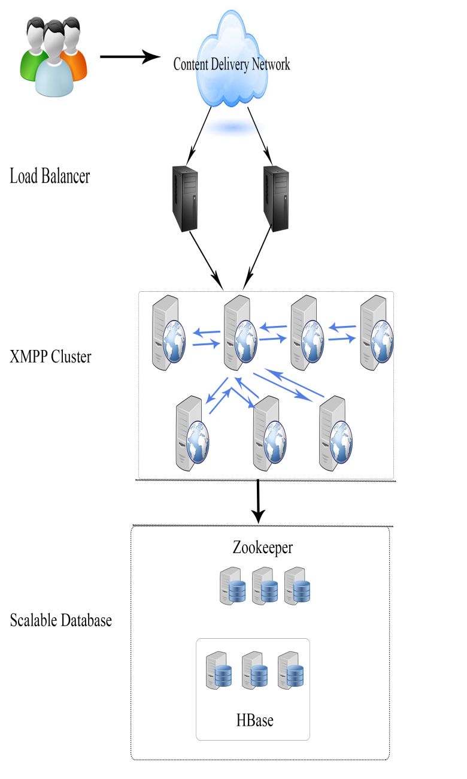

Xmpp Architecture

Slide 3
Xmpp Terminology
Jabber ID a unique ID, each entity has it
The composition
<host>@<domain, subdomain>/<resource>
Ex. qq@test.cluster/mobile1234
Ex. room@conference.test.cluster/qq
Ex. test.cluster
Xmpp Three Format Packet
Presence
IQ
Message (Assure message delivery at least once)

Slide 4
Current Function
Register Account
Presence Status
Personal Profile
User Search
Add/Delete/Block Contact
Change Contact Group
One-On-One Chat
Group Chat
Invite / leave / change group subject
Upload / Share file
Client connection is secure (TLS) and compression (GZip)

Slide 5
Deployment
Federated Deployment
Cluster Deployment
Scenario
Taiwan and US each has one cluster which has more nodes (node communication)
If Taiwan want to communicate with US, choose a PC as a bridge

Slide 6
TODO Task
RDBS to HBase
Schedule 2~3 weeks
Both server and client no history
Need to implement
Integrate with HTC Account

Slide 7
Concern
Privacy Privilege Issue
Do we need to analyze user content?
Do we allow multiple mobile to login the same account?
Mobile should monitor connection status
If connection down, should explicitly notify xmpp server
http://developer.android.com/training/monitoring-device-state/connectivity-monitoring.html

